Slide 1
CCNA (200-125)
OSI Reference Model
Instructor:
Muhammad Naeem
(MSIT/RHCE/CCNP/CCNA/MCSE)
Cell: 0345-5238281
E-Mail: mna571@yahoo.com

Slide 2
Lecture Overview
OSI (Open System Interconnection) Model
OSI Layers
Application Layer
Presentation Layer
Session Layer
Transport Layer
Network Layer
Data Link Layer
Physical Layer

Slide 3
OSI Reference Model

Slide 4
OSI Model
History
In the late 1970s, one project was administered by the International Organization for Standardization (ISO), while another was undertaken by the International Telegraph and Telephone Consultative Committee, or CCITT (the abbreviation is from the French version of the name). These two international standards bodies each developed a document that defined similar networking models.
In 1983, these two documents were merged to form a standard called The Basic Reference Model for Open Systems Interconnection. The standard is usually referred to as the Open Systems Interconnection Reference Model, the OSI Reference Model, or simply the OSI model. It was published in 1984 by both the ISO, as standard ISO 7498, and the renamed CCITT (now called the Telecommunications Standardization Sector of the International Telecommunication Union or ITU-T) as standard X.200.
OSI had two major components, an abstract model of networking, called the Basic Reference Model or seven-layer model, and a set of specific protocols.

Slide 5
OSI Model
Open Systems Interconnection (OSI) is a set of internationally recognized, non-proprietary standards for networking and for operating system involved in networking functions.
A reference model is a conceptual framework for understanding relationships.
The model partitions a communication system into abstraction layers.
The original version of the model defined seven layers.

Slide 6
OSI Layers
All
People
Seem
To
Need
Data
Processing
7. Application Layer
Presentation Layer
Session Layer
Transport Layer
Network Layer
Data Link Layer
Physical Layer

Slide 7
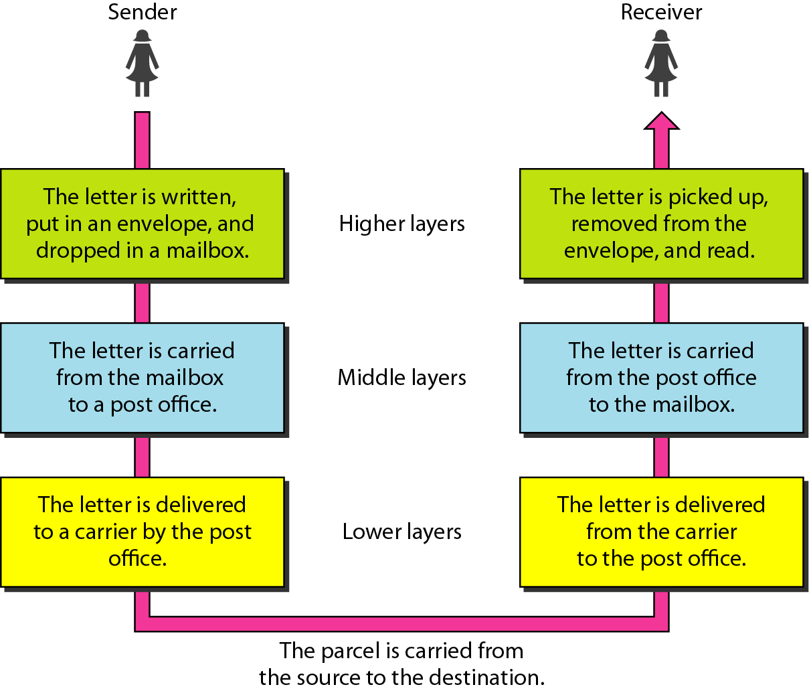
Tasks involved in sending letter

Slide 8
LAYER 7 – The APPLICATION Layer
The top layer of the OSI model
Provides a set of interfaces for sending and receiving applications to gain access to and use network services, such as: networked file transfer, message handling and database query processing

Slide 9
The application layer is responsible for providing services to the user.
Application Layer Protocols;
HTTP
FTP
DNS
SMTP
POP2/POP3
SNMP
Telnet etc.

Slide 10
LAYER 6 – The PRESENTATION Layer
Manages data-format information for networked communications (the network’s translator)
For outgoing messages, it converts data into a generic format for network transmission; for incoming messages, it converts data from the generic network format to a format that the receiving application can understand
This layer is also responsible for certain protocol conversions, data encryption/decryption, or data compression/decompression
A special software facility called a “redirector” operates at this layer to determine if a request is network related on not and forward network-related requests to an appropriate network resource

Slide 11
The presentation layer is responsible for translation, compression, and encryption.

Slide 12
LAYER 5 – The SESSION Layer
Enables two networked resources to hold ongoing communications (called a session) across a network
Applications on either end of the session are able to exchange data for the duration of the session
This layer is:
Responsible for initiating, maintaining and terminating sessions
Responsible for security and access control to session information (via session participant identification)
Responsible for synchronization services, and for checkpoint services

Slide 13
The session layer is responsible for dialog control and synchronization.

Slide 14
LAYER 4 – The TRANSPORT Layer
Manages the transmission of data across a network
Manages the flow of data between parties by segmenting long data streams into smaller data chunks (based on allowed “packet” size for a given transmission medium)
Reassembles chunks into their original sequence at the receiving end
Provides acknowledgements of successful transmissions and requests resends for packets which arrive with errors

Slide 15
The transport layer is responsible for the delivery of a message from one process to another.

Slide 16
LAYER 3 – The NETWORK Layer
Handles addressing messages for delivery, as well as translating logical network addresses and names into their physical counterparts
Responsible for deciding how to route transmissions between computers
This layer also handles the decisions needed to get data from one point to the next point along a network path
This layer also handles packet switching and network congestion control

Slide 17
The network layer is responsible for the delivery of individual packets from
the source host to the destination host.

Slide 18
LAYER 2 – The DATA LINK Layer
Handles special data frames (packets) between the Network layer and the Physical layer
At the receiving end, this layer packages raw data from the physical layer into data frames for delivery to the Network layer
At the sending end this layer handles conversion of data into raw formats that can be handled by the Physical Layer

Slide 19
The data link layer is responsible for moving frames from one hop (node) to the next.

Slide 20
LAYER 1 – The PHYSICAL Layer
Converts bits into electronic signals for outgoing messages
Converts electronic signals into bits for incoming messages
This layer manages the interface between the the computer and the network medium (coax, twisted pair, etc.)
This layer tells the driver software for the MAU (media attachment unit, ex. network interface cards (NICs, modems, etc.)) what needs to be sent across the medium
The bottom layer of the OSI model

Slide 21
The physical layer is responsible for movements of
individual bits from one hop (node) to the next.

Slide 22
Remember
A convenient aid for remembering the OSI layer names is to use the first letter of each word in the phrase:
All People Seem To Need Data Processing

Slide 23
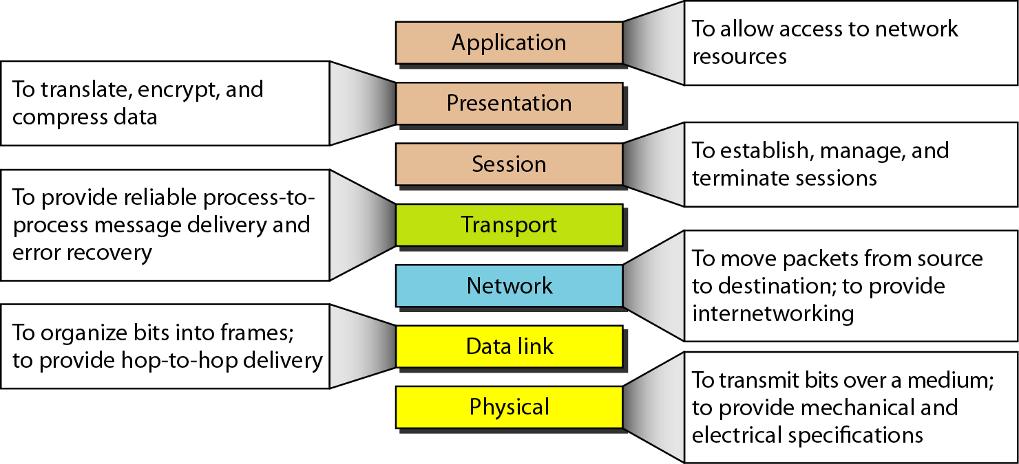

Slide 24
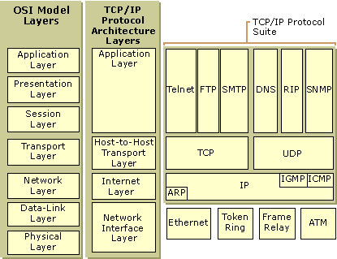
OSI vs TCP/IP

Slide 25
